Slide 1

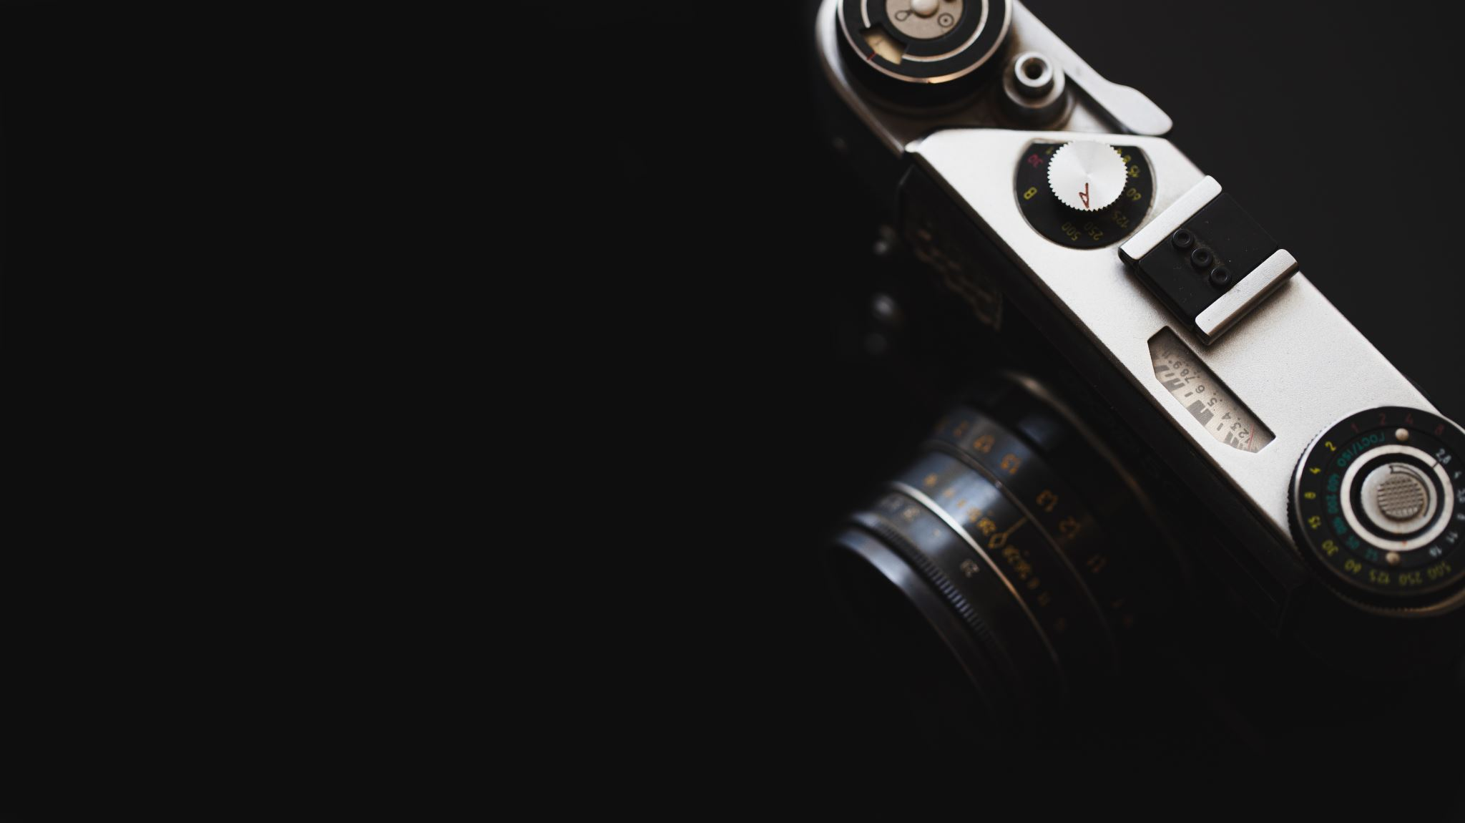
CAMERA – IMU CALIBRATION
Bollimuntha Shreya
2021112014
Md Faizal Karim
2022121004

Slide 2
OVERVIEW
This project deals with the estimates of the spatial and temporal parameters of a camera system with respect to an intrinsically calibrated IMU.

Slide 3
INTRODUCTION
Objective: This project aims to accurately determine the camera's position and orientation in relation to the IMU, which is crucial for precise navigation and mapping in mobile robotics.
Calibration is crucial for autonomous vehicles, drones and robotic mapping systems.
Accurate calibration ensures precise sensor data synchronization, enhancing the performance and reliability of the mobile robot.

Slide 4
METHODOLOGY
There are three steps involved :
Camera calibration
IMU sensor data
Camera – IMU calibration

Slide 5

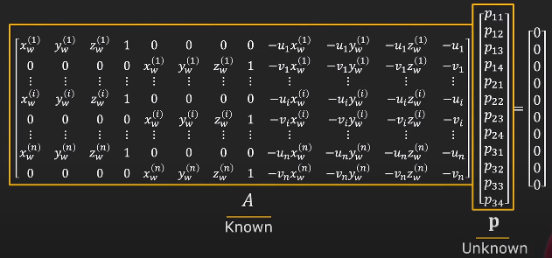
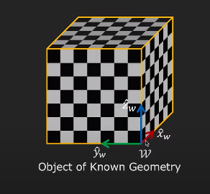

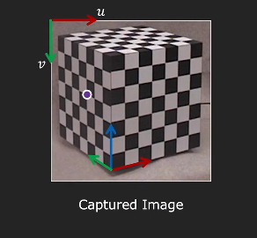
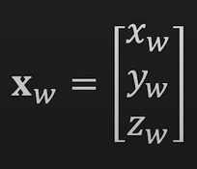
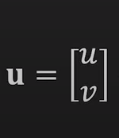
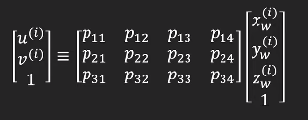
CAMERA CALIBRATION
Camera Calibration involves estimating the projection matrix.
Capture an image of known geometry
Identify correspondences between 3D scene points and image points
For each corresponding point i in scene and image
Rearrange the terms
Solve for p

Slide 6
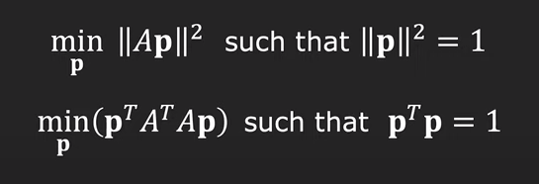



CONSTRAINED LEAST SQUARES SOLUTION
Least Squares Solution for P
Loss Function:
Take the derivative of the loss function with respect to P and set it equal to zero
Solve the eigenvalue problem to find the eigenvector corresponding to the smallest eigenvalue of A transpose
Eigenvector p with smallest eigenvalue λ of matrix A^T.A minimizes the loss function L(p)
Rearrange the elements of P to obtain the projection matrix P

Slide 7
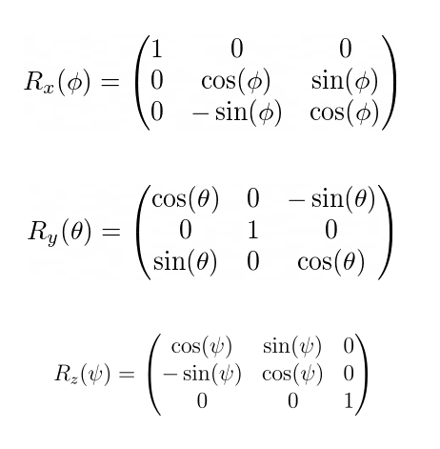
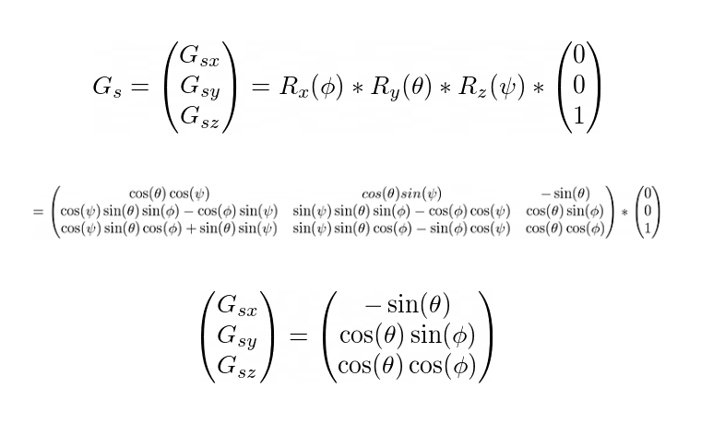

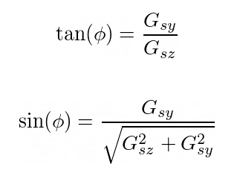
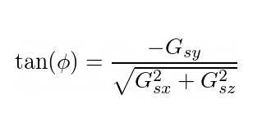
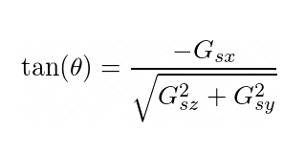
IMU Sensor
Inertial Measurement Unit
An IMU Sensor contains a gyroscope, magnetometer, and an accelerometer.
It gives us the pose of a mobile robot. (x,y,z,r,p,y).
Estimating roll and pitch from accelerometer
Roll is rotation about x axis
Pitch is rotation about y axis

Slide 8
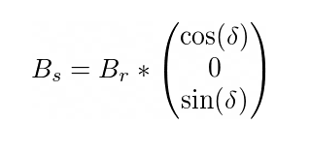
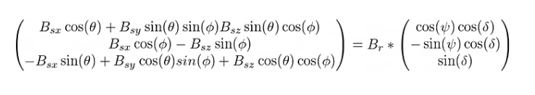
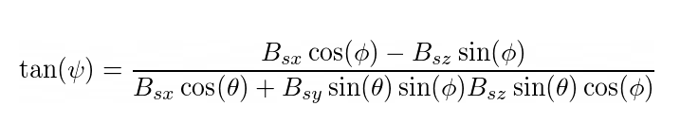
Estimate yaw using magnetometer

Slide 9
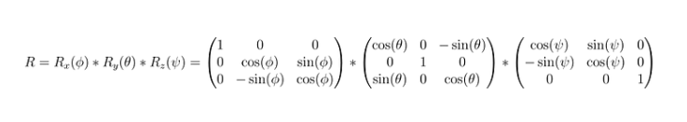
Rotation Matrix using IMU Sensor
The acceleration values stacked up give us the rotation matrix

Slide 10
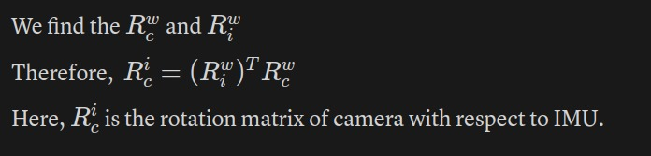
Camera – IMU Calibration
We find the $R^w_c$ and $R^w_i$
To find $R^i_c$
$R^i_c$ = $(R^w_i)^T. R^w_c$
$R^i_c$ is the required matrix for camera–imu calibration

Slide 11
Progress So Far
Theory - Camera IMU calibration
Determined the algorithm to be used
Mounted the camera on a mobile robot
Collected data using gazebo simulations

Slide 12
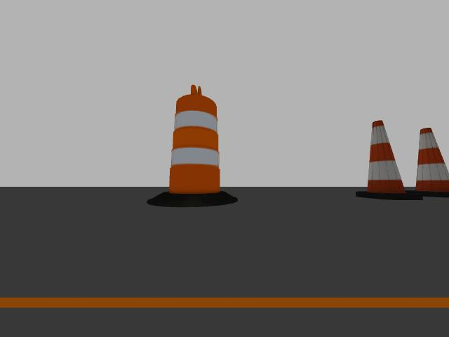
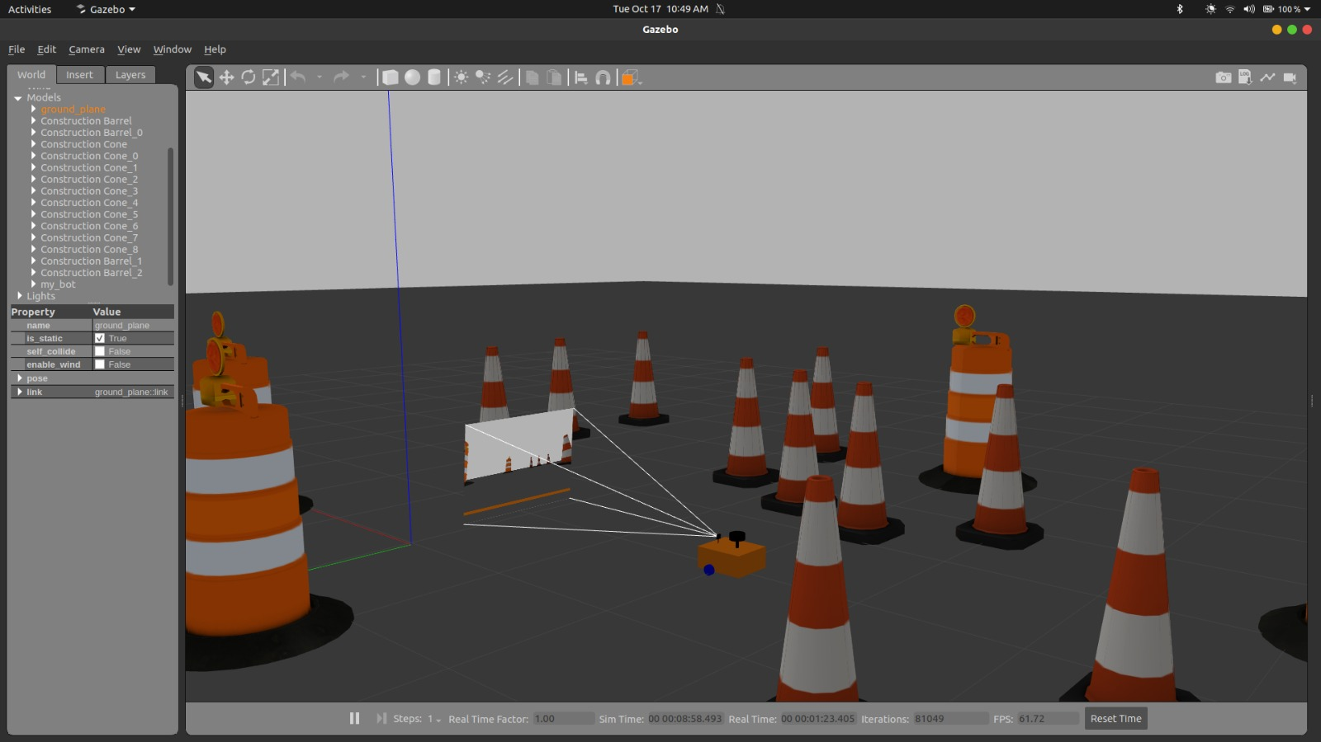
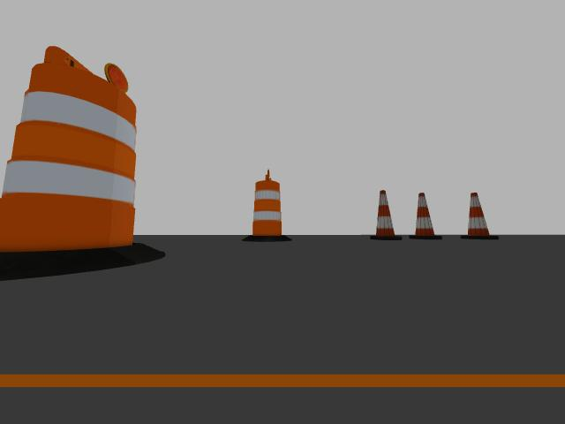
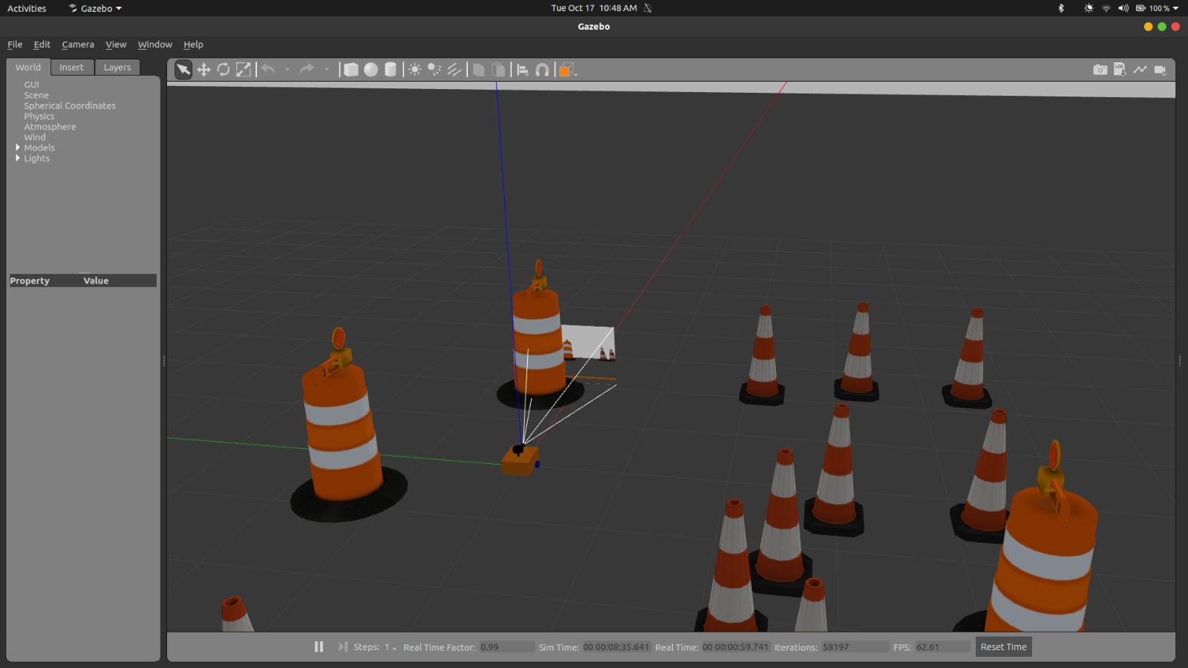
Results
Gazebo Environment and their respective images are shown.

Slide 13
Plan Of Action
Simulate the IMU sensor on gazebo - 22nd Oct
Get the IMU Sensor's data – 22nd Oct
Find the relative rotation matrices of camera with respect to the IMU. - 27th Oct
Collect camera data from hardware – 03rd Nov
Collect IMU data from hardware – 10th Nov
Find the calibrated values – 15th Nov

Slide 14
Challenges Faced
Simulating the mobile robot in Gazebo environment
Simulation of pixhawk 2.4.8 in gazebo

Slide 15
Project Repository
https://github.com/Mobile-Robotics-IIITH-2023/project-the-ro-bots

Slide 16
Thank you

